Slide 1

Docker and K8s
Huawei India

Slide 2
Agenda
Introduction to Virtualization, VMs and Containers
Introduction to Docker
Concepts of Layers of Docker Images and CoW
Building an Image, Tag, Push to Docker Hub, Pull and Run
Managing Container Orchestration using Kubernetes.
How to become a contributer ?
How to expand this community.

Slide 3
Part 1: Introduction to Virtualization, VMs and Containers

Slide 4
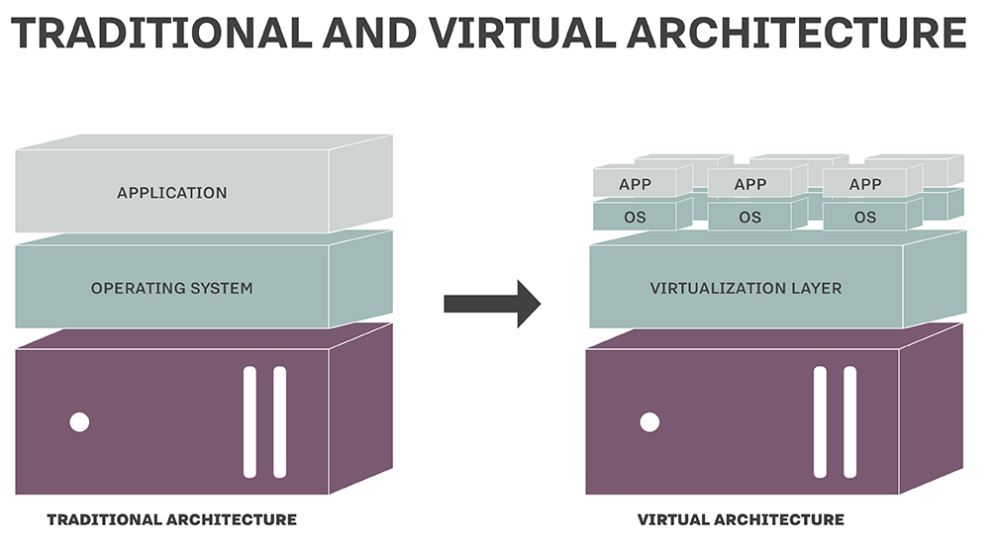
Introduction to Virtualization
Need For Virtualization
Fault Tolerance
Migration is Simpler
Increased Resilience
Lower operating costs, reduced power consumption and greater overall reliability
Greater Hardware Utilization
Better Management of Resources

Slide 5
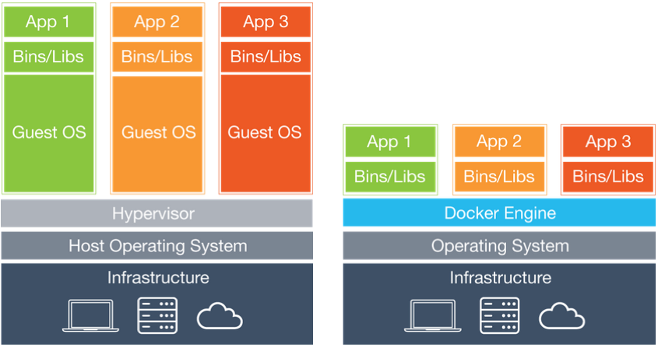
A Comparison of VMs and Containers
Virtual Machines (VMs)
Hypervisor – VMMs (Virtual Machine Manager)
Hosted Virtualization
Bare Metal Virtualization
Performance Comparison
Notes:
Hosted Virtualization - VMware Workstation, Microsoft's Virtual PC, Microsoft Hyper-V
Bare Metal Virtualization – Virtual Box, VMware ESX and Citrix Xen Servers

Slide 6
A Comparison of VMs and Containers
Containers
Isolation of application environments
Resource isolation
All of these without impacting performance
Cgroups and Namespaces

Slide 7
Part 2: Introduction to Docker

Slide 8
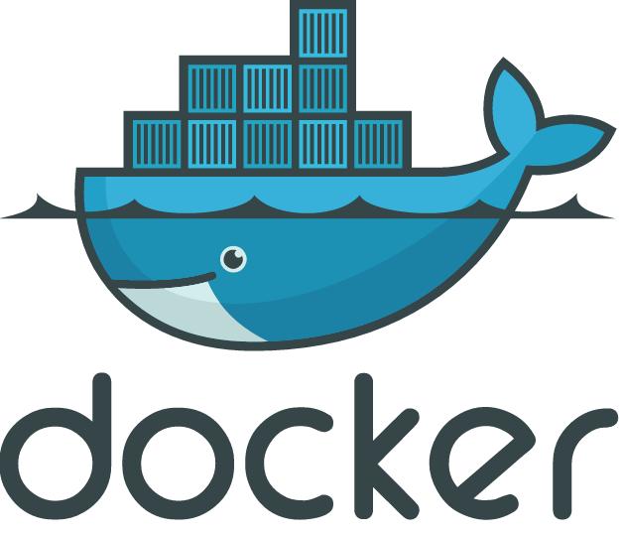
Introduction to Docker

Slide 9
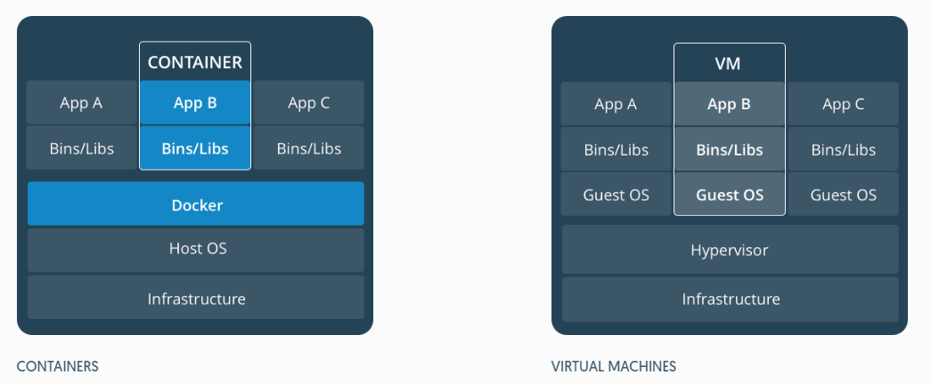
Docker Architecture

Slide 10
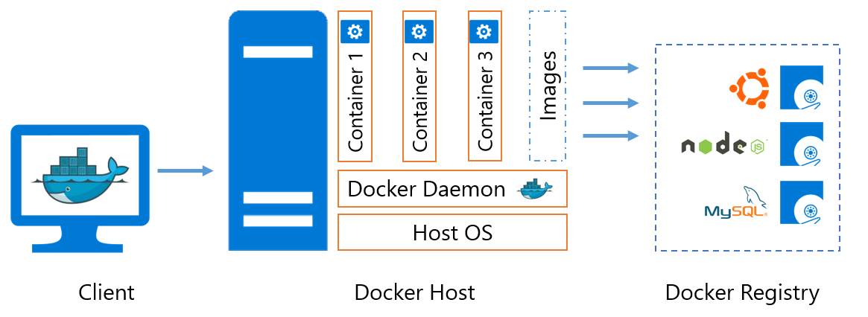
Docker Architecture (Contd…)

Slide 11
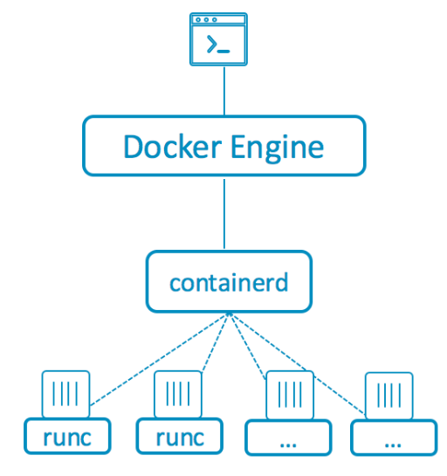
Docker Architecture (Contd…)

Slide 12
Salient Features of Docker
Isolation
Lightweight
Simplicity
Workflow
Community

Slide 13
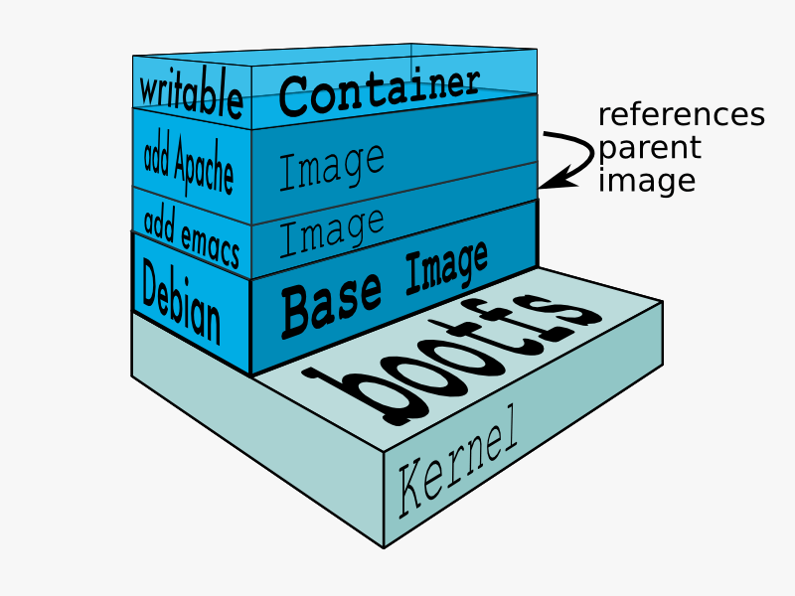
Docker Images
Blueprints for containers
Build component of Docker
Provides a simple way of building new images or updating existing images

Slide 14
Docker Containers
Runnable instance of a Docker image
Another form of virtualization
Allows pieces of code to be put into smaller, easily transportable pieces that can run anywhere Linux is running

Slide 15
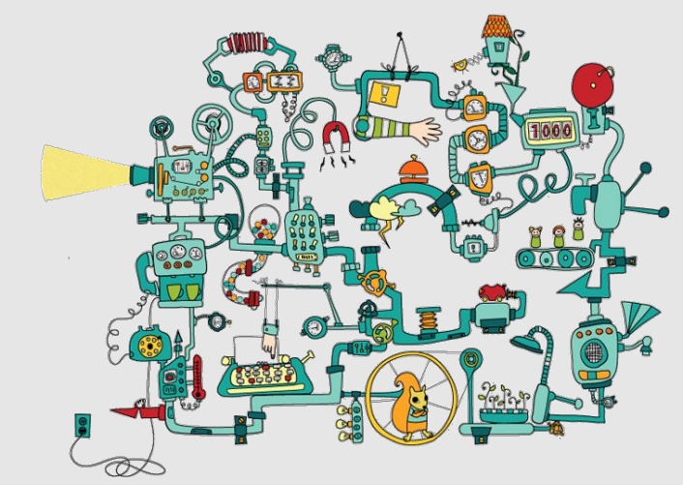
Containers Before Docker

Slide 16
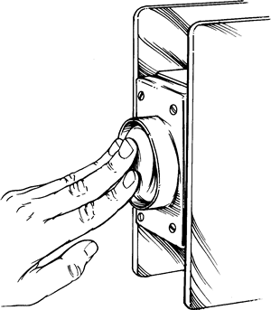
Containers After Docker

Slide 17
Basic Hands-On Using Existing Docker Images

Slide 18
Part 4: Concepts of Layers of Docker Images and CoW

Slide 19
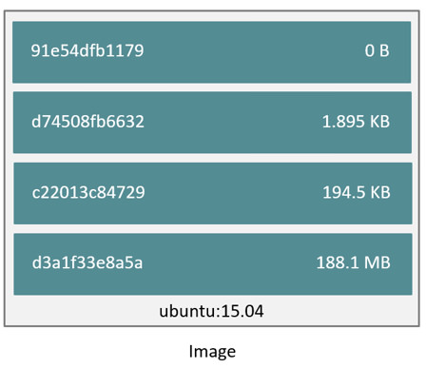
Docker Images and Layers

Slide 20
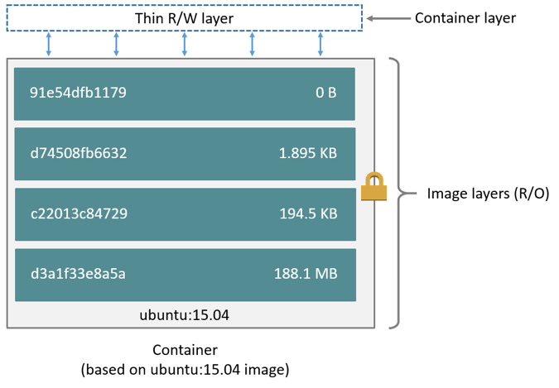
Docker Images and Layers (Copy on Write Strategy (CoW))

Slide 21
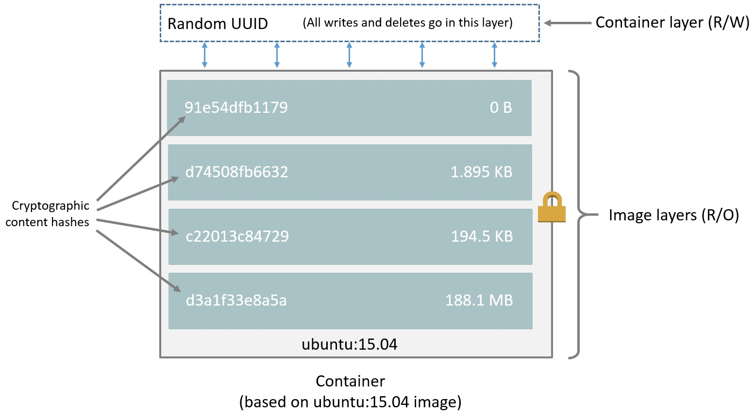
Content Addressable Storage Model

Slide 22
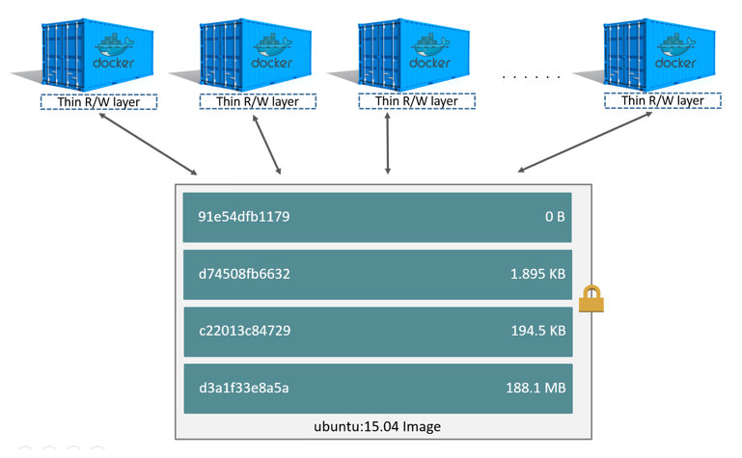
Containers and Layers

Slide 23
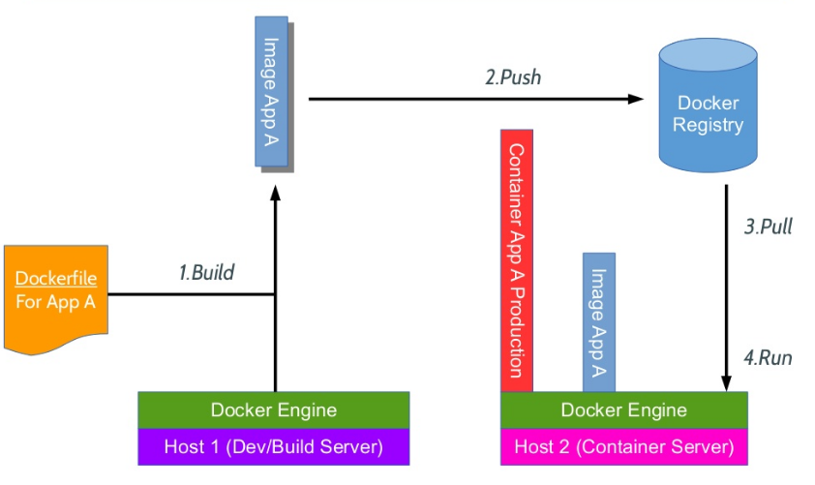
Docker Workflow

Slide 24
Hands-On of Images, Layers and CoW Concept

Slide 25
Part 5: Building an Image, Tag, Push to Docker Hub, Pull and Run

Slide 26
Building an Image
1. Write a Dockerfile
2. Build Image from Dockerfile
3. Run the New Image

Slide 27
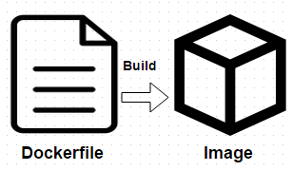
Write a Dockerfile
A Dockerfile is a text document that contains all the commands you would normally execute manually in order to build a Docker image.
Docker can build images automatically by reading the instructions from a Dockerfile.

Slide 28
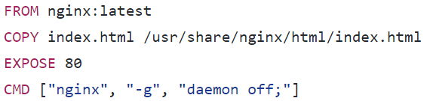
Example of a Dockerfile

Slide 29
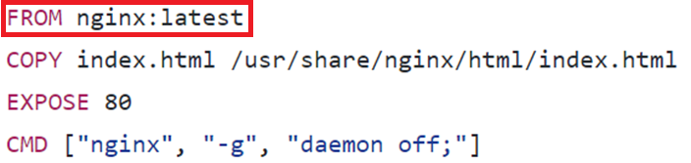
Example of a Dockerfile (Contd…)
The FROM keyword tells Docker which image is your image based on

Slide 30
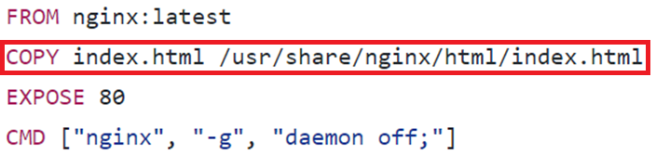
Example of a Dockerfile (Contd…)
The COPY instruction copies new files or directories from <src> and adds
them to the filesystem of the container at the path <dest>

Slide 31
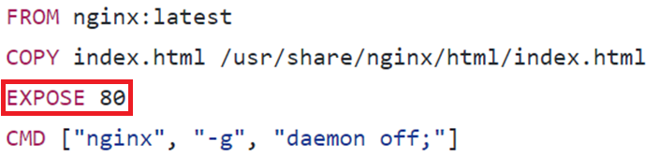
Example of a Dockerfile (Contd…)
The EXPOSE instruction informs Docker that the container
listens on the specified network ports at runtime
(Note: EXPOSE does not make the ports of the container accessible to the host)

Slide 32
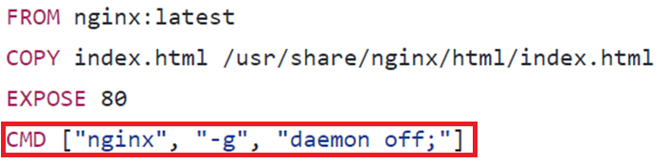
Example of a Dockerfile (Contd…)
The main purpose of a CMD is to provide defaults for an executing container
(Note: There can be only one CMD in a Dockerfile. If multiple CMDs are there,
then only the last CMD will take effect)

Slide 33
Build Image from Dockerfile
docker build command is used to build the docker image
The -t parameter gives image a tag, so that one can run it more easily later
The . command tells the docker to look in the current directory for a file called Dockerfile
docker build -t nginx:hello_world_image .

Slide 34
Run the New Image
Running the new image is simple
Check the docker images and see if the newly created image is present
Just execute the following command and container with the new image will come up
docker run nginx:hello_world_image

Slide 35
Run the New Image
Running the new image is simple
Check the docker images and see if the newly created image is present
Just execute the following command and container with the new image will come up
docker run nginx:hello_world_image

Slide 36
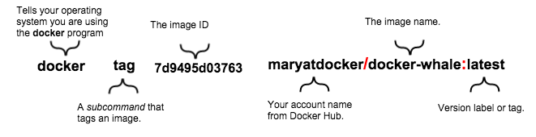
Docker Tag

Slide 37
Docker Push and Pull
Create an account in Docker Hub
Docker push the image which you tagged
Docker hub account would contain the pushed image
Now one can pull the image and run a container using the image

Slide 38
Hands-On of Dockerizing, Tagging, Pushing and Pulling

Slide 39
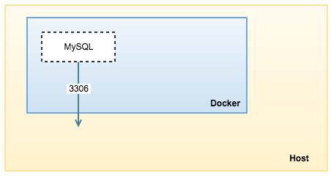
MySQL + WordPress Application

Slide 40
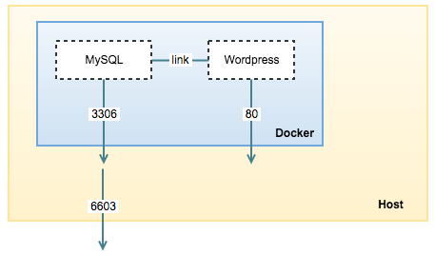
MySQL + WordPress Application (Contd…)

Slide 41
Hands-On of MySQL + WordPress Application

Slide 42
Kubernetes WorkShop

Slide 43
Need Orchestration Layer

Slide 44
Use Case
WordPress
MySQL
Docker
LoadBalacer
Service
WordPress
WordPress
WordPress
MySQL
Docker

Slide 45
What a Typical Orchestration supports
Maintaining the lifecycle of the container application.
Managing Services, Volumes, Networking across containers.
Support container Scaling to meet the demand.
Logging and monitoring

Slide 46
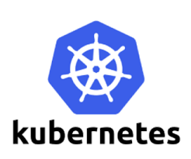
What is Kubernetes
o Kubernetes is a Container Orchestration Systems developed and open-sourced by Google.
o Kubernetes manages a cluster of nodes (VM’s or BareMetals) and is responsible for
§ Perform Scheduling decisions on which node to run workloads.
§ Manage Container Runtimes (like docker, rocket, etc) to initiate Container creation and maintenance.
§ Responsible for maintaining the state of the overall application (which consists of multiple containers, running on multiple nodes).
o Kubernetes also,
§ Enables decoupling of application components.
§ Ensuring zero-downtime during application updates.

Slide 47
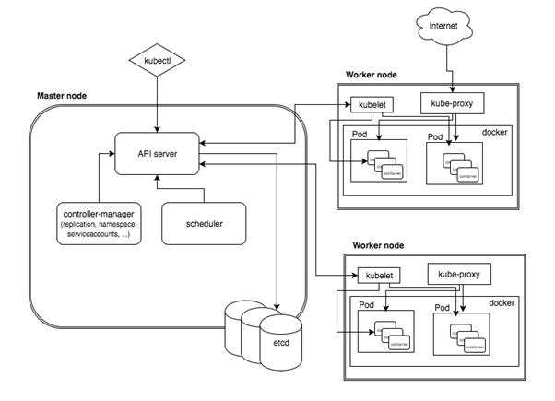
Kubernetes Architecture

Slide 48
Master Node Components
Api Server
Scheduler
Controller Manager
Ectd

Slide 49
Worker Node Components
Kubelet
Kube-Proxy
Docker

Slide 50
Various Available Setup Methods
On Cloud infrastructure
Google
AWS
Azure
IBM Blue Mix
On local machine / Bare metal
MiniKube
Ubuntu on LXD
IBM Cloud Private CE
Kubeadm – If already configure hosting resource are avaliable.

Slide 51
Installing Kubernetes with Kubeadm
Supported Platform
Ubuntu 16.04+, CentOS 7 or HypriotOS v1.0.1+
On bare metal, cloud Hosted VM’s
Master Node requirements
Kubeadm
Kubectl
Docker
Kubelet
Worker Node requirements
Kubeadm
Docker
Kubelet

Slide 52
Steps for using Kubeadm
Installing kubeadm on your hosts
Initializing your master
Installing a pod network
Joining your nodes

Slide 53
What is a POD ?
POD
Init
C1
POD
POD
C1
Main
C1
C2
Side
Car
POD is the new VM (Group of Containers)
Shared Storage and Network Namespace by default
Now optionally share PID namespace aswell

Slide 54
What is a POD ?
POD
LifeCycle of Container
Hooks
Post-Start
Pre-stop
Probe
Readiness
Livelyness
InitContainers
C1
Containers
Readyness
C1
Post-Start
Liveliness
Pre-Stop

Slide 55
Types of Workloads
StatefulSet - Stateful Application that needs reasonable hand holding
Like Database
In-memory Cache
Peer – Peer applications that needs storage
Any application that needs network identity
Deployment - For stateless application to deal with complex workflow
Like webservers
Are stateless in nature that needs on-demand scale
Needs rolling update
Jobs - Run once type of workloads
Useful for running scripts, reports and batch jobs
Like DB-Query
Like Spark / Hadoop processing
CornJobs – Run once type of Jobs by repeat in a frequency
Just like unix CornJob
Runs a job at a given schedule
DaemonSet – Run on all the Nodes as much as possible
Runs in every node in the cluster.
For starting monitoring applications on every node.
ReplicaSet – Run and manage multiple Pods lifecycle.
Elementry Controller for managing PODs
Used by Deployment.

Slide 56
A Closer Look at Deployment
Most popular workload controller so far.
Has been applied and tested with several Usecases
Works on a higher level abstraction layer.
Ie: Manages ReplicaSet instead of directly managing PODs
Manages revisions of the replicasets so that rolling updates can be performed
Deployment
ReplicaSet
POD
POD
POD

Slide 57
A Closer Look at Deployment
type DeploymentSpec struct {
Replicas *int32
Selector *metav1.LabelSelector
Template v1.PodTemplateSpec
Strategy DeploymentStrategy
MinReadySeconds int32
RevisionHistoryLimit *int32
Paused bool
ProgressDeadlineSeconds *int32
}
kind: Deployment
metadata:
name: bash-deployment
spec:
replicas: 3
template:
metadata:
labels:
app: bash
spec:
containers:
- name: bash-app
image: bash
command: [ "/usr/local/bin/bash", "-c", "--" ]
args: [ "while true; do sleep 1; echo :`date`;done;" ]
ports:
- containerPort: 80

Slide 58
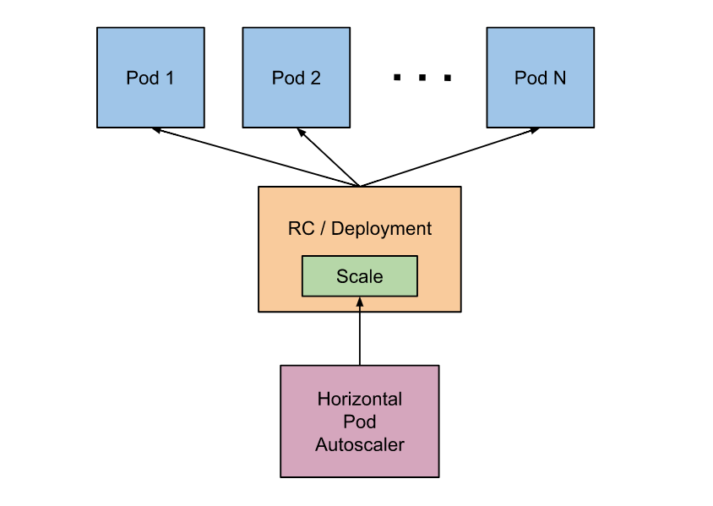
How to autoscale works?
Needs Heapster and Cadvisor (already a part of Kubernetes)
https://kubernetes.io/docs/tasks/run-application/horizontal-pod-autoscale/
ResourceMetricSource (CPU or Memory)
Our Demo will cover

Slide 59
Updating your workload
Deployment
Re-Create
Roling Update
Statefulset
Rolling Update
OnDelete
Deployments Rolling Update
type RollingUpdateDeployment struct {
MaxUnavailable *intstr.IntOrString – Max replicas can be deleted at atime
MaxSurge *intstr.IntOrString – Maximum additional replicas can created while updating.
}
Deployment
10% Surge – Rolling update
ReplicaSet V1
ReplicaSet
V2
POD
50=repl
POD
5=repl

Slide 60
Workload co-location requirements
Application co-location Preferences
Uses Cases
Don’t Run Workload ‘X’ and ‘Y’ on the same node
Database replicas.
Shards
Highly Network intensive webservers that are horizontally scalable
Always Run WorkLaod ‘X’ and ‘Y’ on the same node
Workload and local cache
Co-operating workloads that belong to different controlers
Eg: DB and Big-Query

Slide 61
Workload co-location requirements
Inter-Pod Affinity and Anit-Affinity.
Recommendation to the Scheduler
Two Types
Affinity :- Always co-locate with the pod with lable key=value
Anti-Affinity :- Never co-locate with the POD with key=value
Scheudler rules
requiredDuringSchedulingIgnoredDuringExecution
preferredDuringSchedulingIgnoredDuringExecution

Slide 62
Workload Disruption Management
How to ensure that you application is always running ?
Bringing down nodes for maintenance without hurting your workloads performance
Example:
Minimum number of replicas that can tollerate disruption
Eg: https://kubernetes.io/docs/tasks/run-application/configure-pdb/
apiVersion: policy/v1beta1
kind: PodDisruptionBudget
metadata:
name: zk-pdb
spec:
minAvailable: 2 (we can also mention in %)
selector:
matchLabels:
app: zookeeper

Slide 63
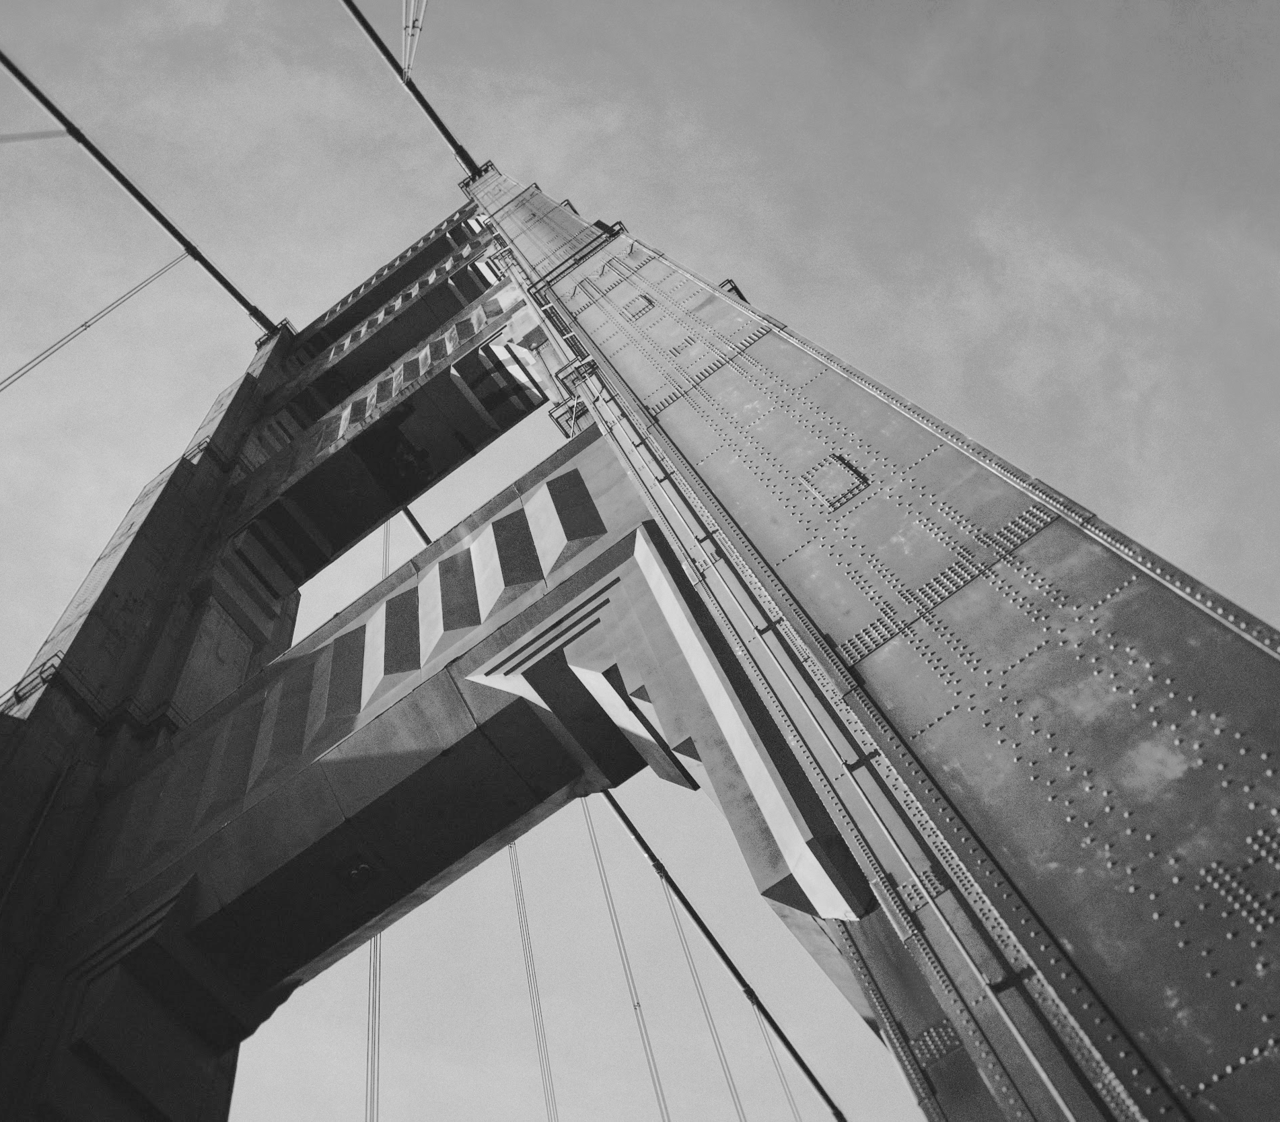
Thanks!

